Slide 1
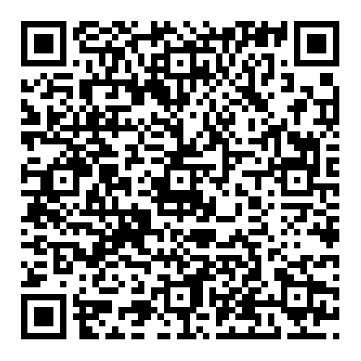
Battle of the Bots
Workshop number 1:
Arduino Basics
Motor Control
By GWU IEEE and Robotics

Slide 2

Arduino Platform
Arduino is an open source electronics platform
They provide easy to use general purpose microcontroller boards and solutions
Ideal for projects that require reading inputs and producing outputs
To program Arduinos, use the Arduino IDE: https://www.arduino.cc/en/software

Slide 3
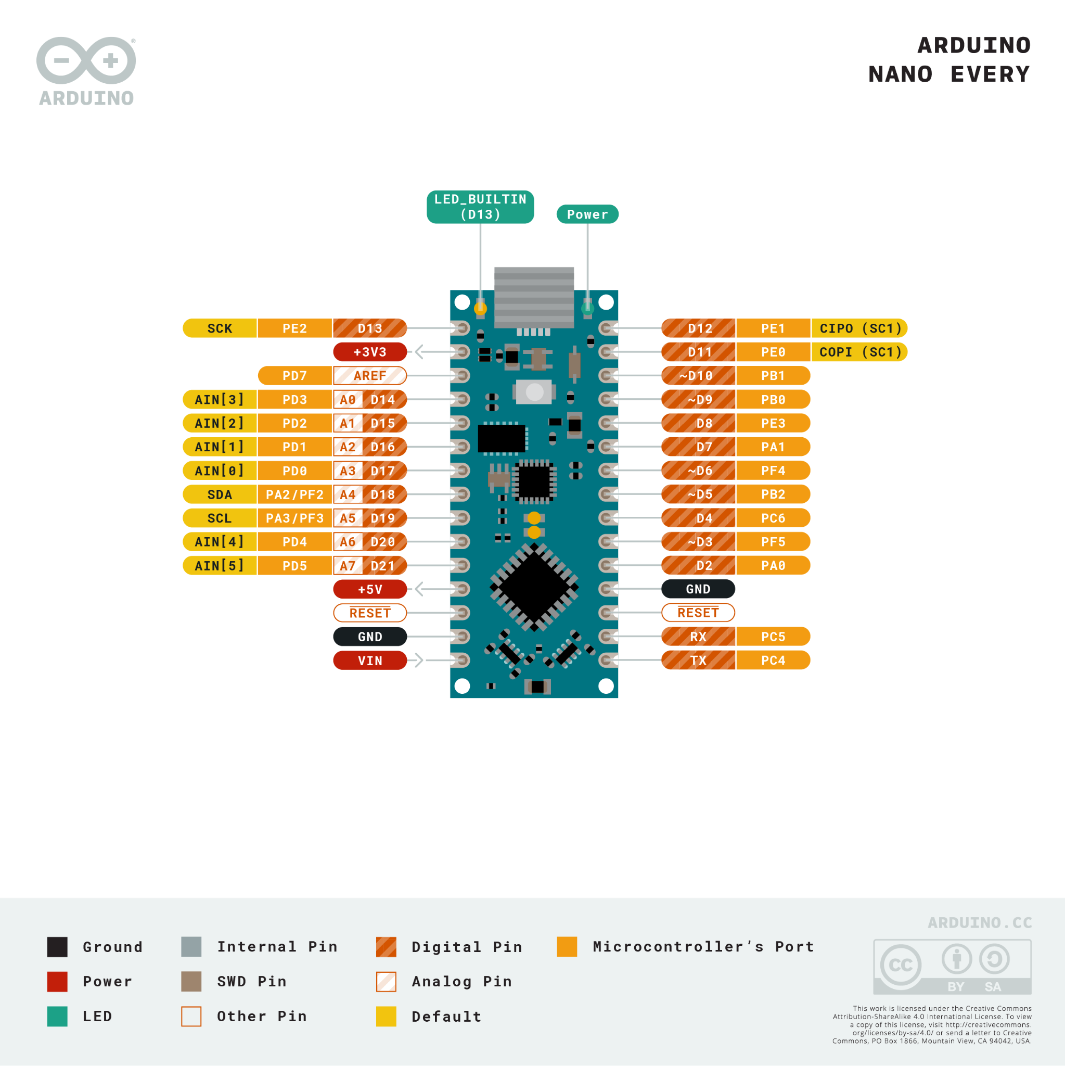
Arduino Nano
Arduino Nano is a small but complete board
Digital I/O pins:14
Analog Input pins: 8
Programmed via mini USB Type-B
Input Voltage: 7-12V(we will connect a 9V battery to the Vin pin)
Logic: 5V

Slide 4
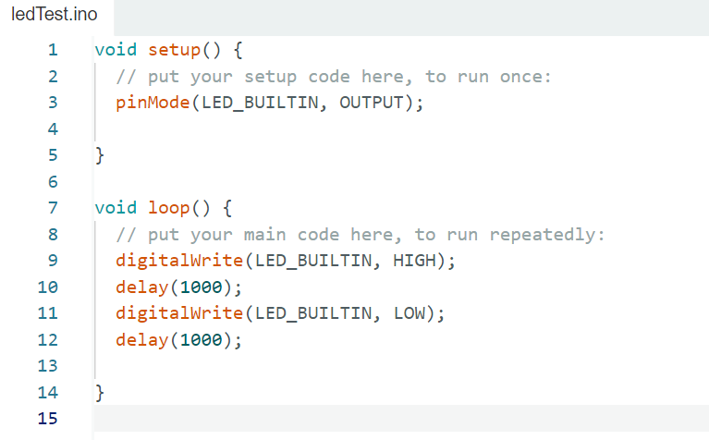
Basic Program
pinMode(Pin Number, mode):
Digital I/O: mode can be set to input or output
Analog input pins: mode input only
digitalWrite(Pin Number, Output):
Output set to HIGH or LOW
HIGH = 5V LOW = 0V
delay(time in ms):
Stop the program execution for 1000ms
Code to Test Board

Slide 5
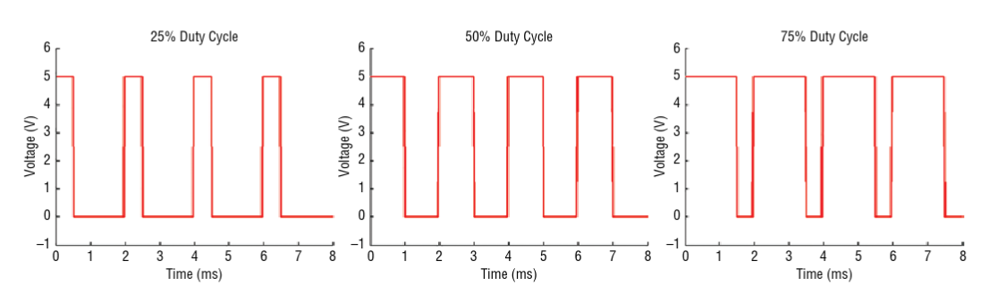
AnalogWrite() vs DigitalWrite():
digitalWrite() and the I/O pins can only be used to output 5V or 0V, but there will be scenarios where we will need the voltage to be somewhere in between.
Controlling motor speed is one of those examples.
PWM(power-width modulation) is a possible solution. Pins 3,5,9,10

Slide 6
AnalogWrite() vs DigitalWrite():
analogWrite(PIN, value) //where value ranges from 0-255.
analogWrite(PIN,64): output equivalent to 1.25V
analogWrite(PIN, 128): output equivalent value to 2.5V
analogWrite(PIN, 191): output equivalent value to 3.75V

Slide 7
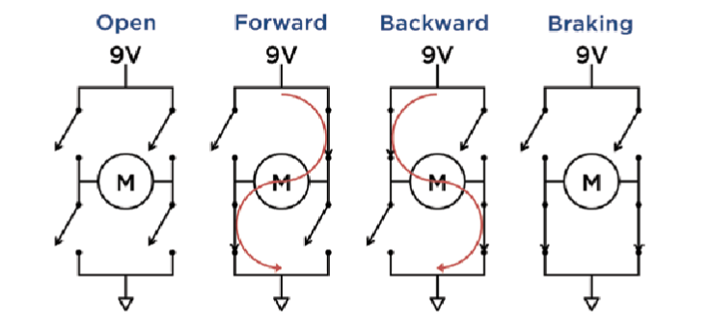
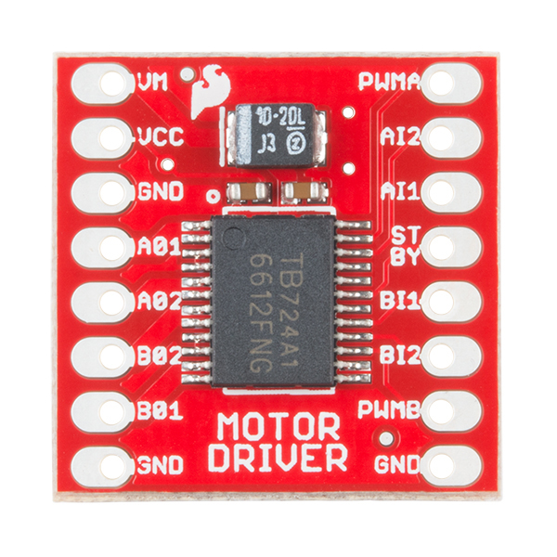
Motor Control:
Motor demand more power than the I/O pins in the arduino can deliver
Motor can generate spikes that may damage the Arduino
Connect Motor to TB6612FNG and 9V battery:
TBB6612FNG contains two H-bridge:
AI1
AI2
AI2
AI1

Slide 8
Motor Control:

Slide 9
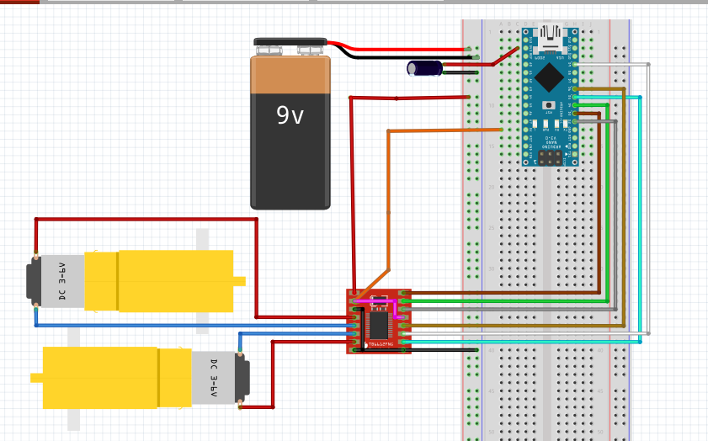
Motor Control: Circuitry

Slide 10
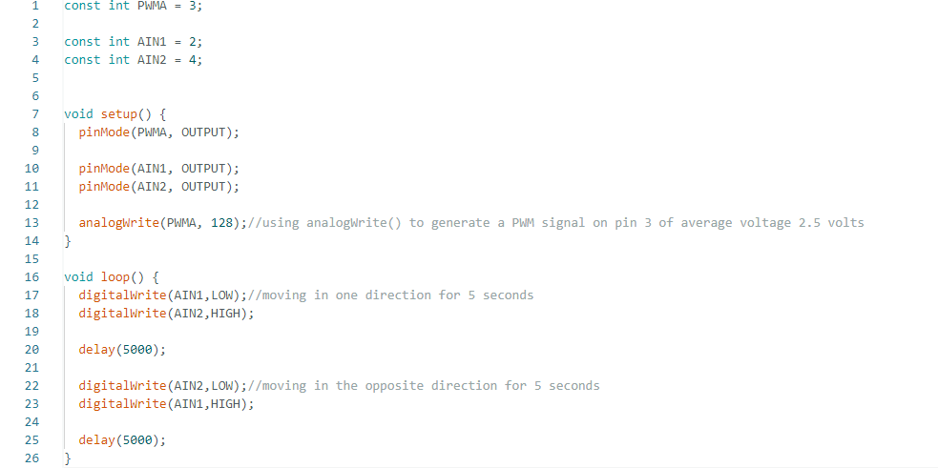
Motor Control: Code
Motor Test Code

Slide 11
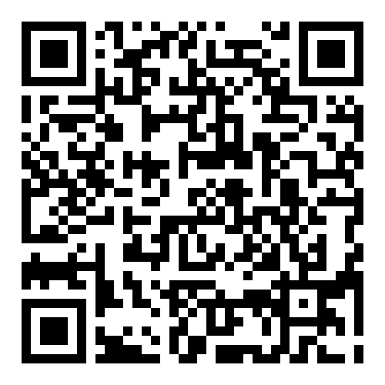
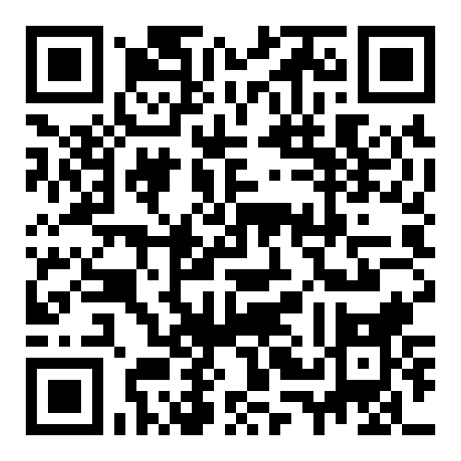
Join Engage
GW Robotics Engage GW IEEE Engage

